Slide 1

DATA ANALYTICS CAPSTONE · GROUP 1
Economic growth and quality of life in East Africa
World Bank evidence for the East African Community · 2010 – 2024
8
15
4
6
Partner States
Years
Indicators
Research questions
Amenya Maeri (222657) · David Muriuki(223108) · Joel Mutevu (122173) · Sharon Olang(225637) · Magembe Omeri(225518)
Client: East African Community (EAC)
GROUP 1 · EAST AFRICAN COMMUNITY
01
Notes:
Open with the central question: did economic growth translate into longer lives and better access to education?
[Sources]
- Assignment brief: Data Analytics Group Project-2.pdf
- Official Strathmore University logo: https://strathmore.edu/wp-content/uploads/2023/08/University-Logo-01-1.png
- Strathmore Brand Identity Guidelines, page 16: official blue #3848A2, gold #C79633, red #E52D2C, and yellow #F4CE67
[/Sources]

Slide 2
TEAM CONTRIBUTION
Group 1
Amenya Maeri
API retrieval and raw JSON
David Muriuki
Quality checks and preprocessing log
Sharon Olang
Statistics, charts, and saved results
Joel Mutevu
Streamlit app, tests, and deployment guide
Magembe Omeri
Presentation and final datasets
GROUP 1 · EAST AFRICAN COMMUNITY
15

Slide 3
PROJECT EXPECTATIONS
1 – 3
Building a trustworthy dataset
4 – 5
Finding and explaining patterns
6 – 9
Delivering something useful
We retrieved data with Python, checked its quality, then cleaned it without hiding missing values.
Used exploratory analysis, at least three statistical techniques, and meaningful charts with clear reasons.
Built an interactive dashboard, make evidence-based recommendations, work as a team and kept the project on GitHub.
Our client question
Which countries grew fastest and did people also live longer and gain better access to secondary school?
GROUP 1 · EAST AFRICAN COMMUNITY
02

Slide 4
EXPECTATION 1 · API DATA RETRIEVAL
1
Call the API
2
Keep the original
3
Create analysis rows
Python requested each indicator for all eight countries and all years.
Every API response was saved in one raw JSON file.
The responses were reshaped into 120 country-year records.
World Bank Indicators API v2
120
82.1%
GET /v2/country/{EAC codes}/indicator/{indicator}
country-year rows
values observed
date=2010:2024 · format=json · per_page=20000
Indicators: real GDP/person · GDP growth · life expectancy · secondary enrolment
8 countries × 15 years
of all expected cells
GROUP 1 · EAST AFRICAN COMMUNITY
03

Slide 5
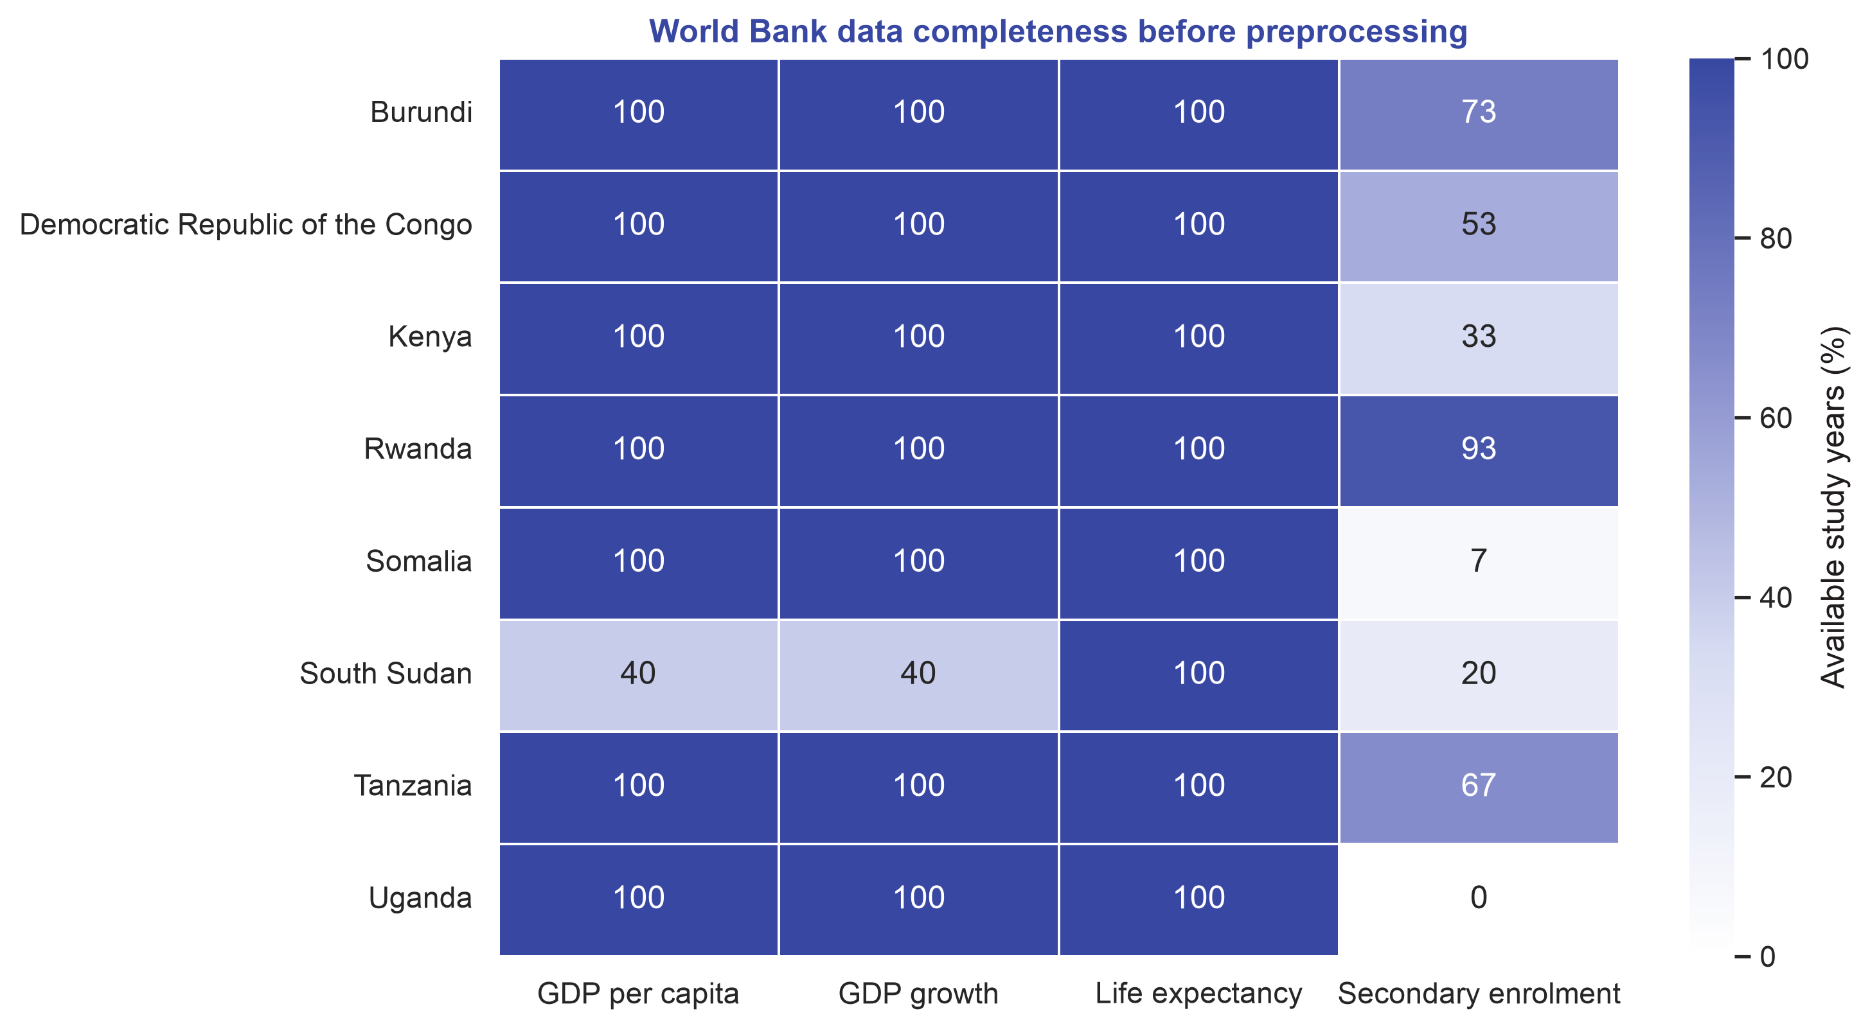
EXPECTATION 2 · DATA QUALITY ASSESSMENT
0
86
duplicate rows
missing values
before cleaning
16
43.3%
outlier candidates
education observed
flagged by the IQR rule
largest original gap
What this told us
Most missing cells were in secondary enrolment. We also separated unusual values from values that were genuinely impossible.
GROUP 1 · EAST AFRICAN COMMUNITY
04

Slide 6
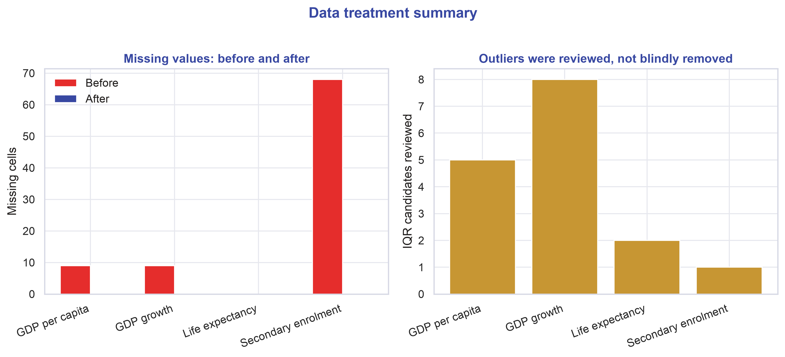
EXPECTATION 3 · PREPROCESSING DECISIONS – DATA CLEANING.
86
0
values imputed
blanks after
each one is flagged
in the 4 indicators
16
0
outliers reviewed
confirmed errors
all documented
plausible values retained
How we handled it
Internal gaps used each country’s trend. Edge gaps used the regional year pattern adjusted to that country. Missing GDP growth was recalculated from completed GDP. Every estimate keeps its method.
GROUP 1 · EAST AFRICAN COMMUNITY
05

Slide 7
EXPECTATION 4 · EXPLORATORY AND STATISTICAL ANALYSIS - TECHNIQUES USED.
01
Trend analysis
02
Correlation
03
Regression
We measured changes through time and compared the start and end of the study period.
Pearson and Spearman tests showed the strength of the link between income and life expectancy.
A model controlled for country differences and the passage of time, using robust standard errors.
The useful lesson
Completed panel
r = 0.109 · p = 0.238
Controlled GDP p
0.002 complete · 0.098 reported
The GDP–life result changes when estimates and controls are handled differently.
GROUP 1 · EAST AFRICAN COMMUNITY
06

Slide 8
EXPECTATION 5 · DATA VISUALISATION TOOLS
Line chart
Shows year-by-year direction and turning points.
Ranked bar chart
Makes the highest and lowest change easy to spot.
Indexed line chart
Compares indicators with different units from a common starting point.
Scatter + trend line
Shows the relationship, spread, and unusual cases.
Heatmap
Compares several indicators and countries in one compact view.
Geographic map
Shows where outcomes differ across the region.
Best practices: clear units · sorted comparisons · consistent country colors · readable labels
GROUP 1 · EAST AFRICAN COMMUNITY
07

Slide 9
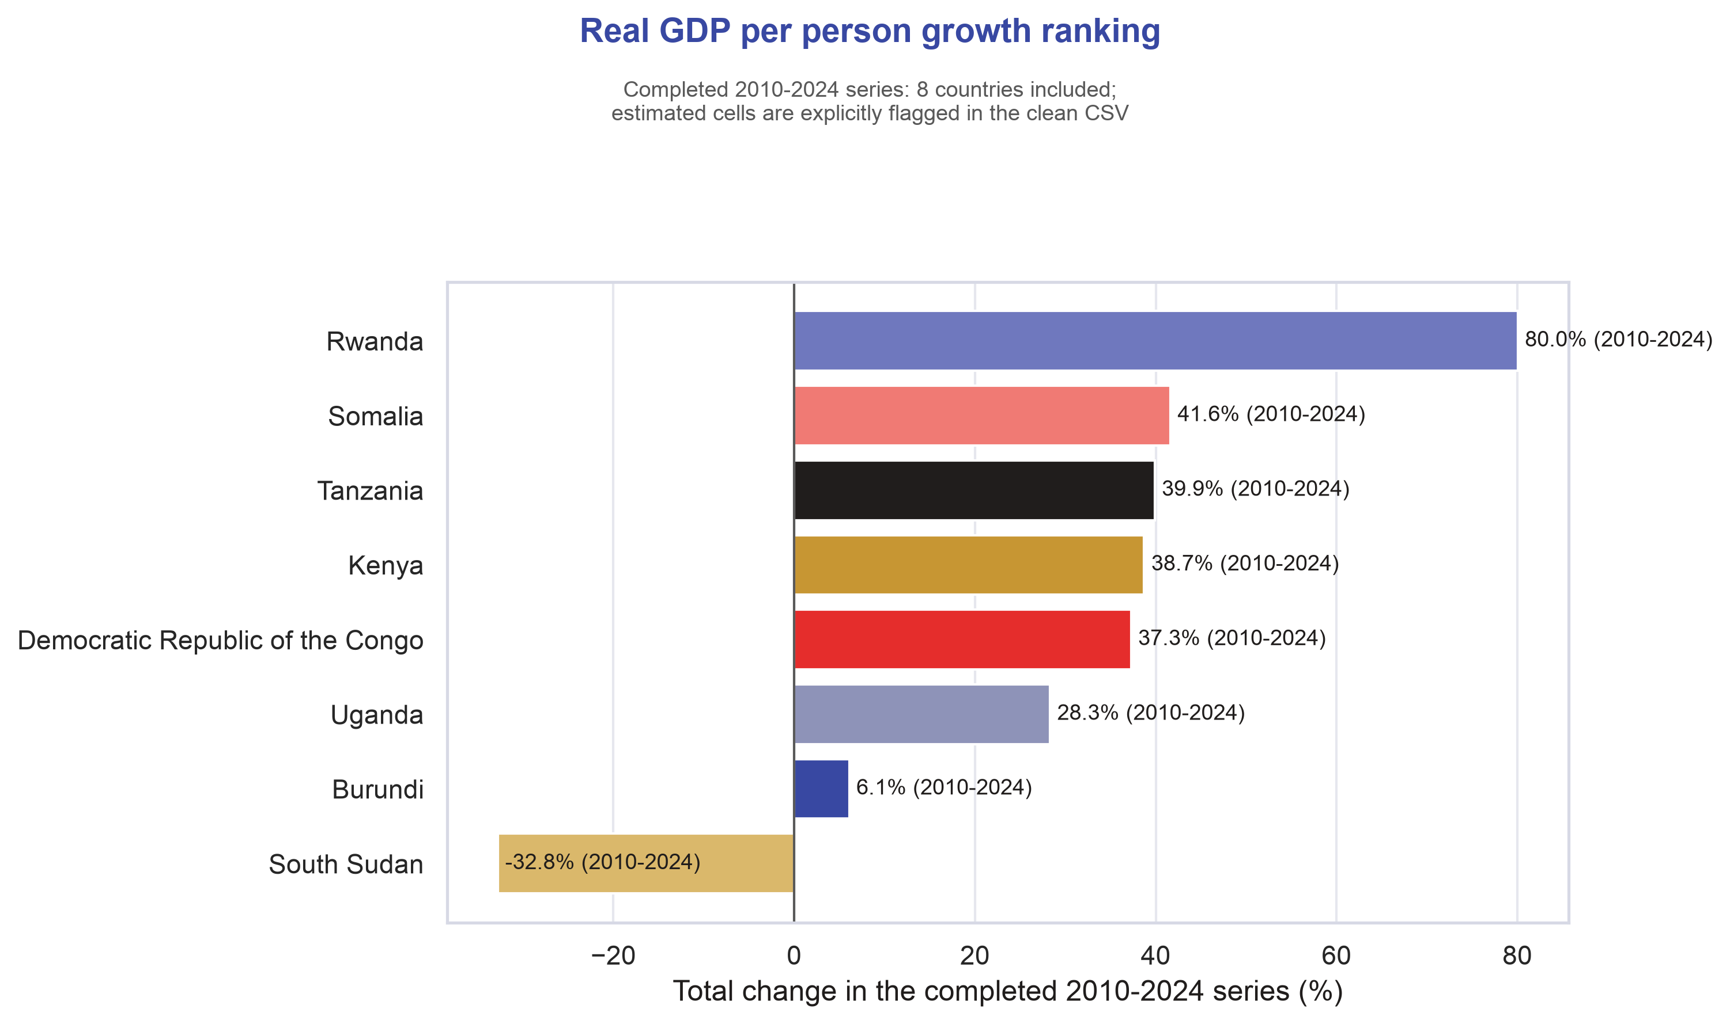
RESEARCH QUESTION 1
Real GDP-per-capita Growth Ranking
Answer: Rwanda increased by 80.0% between 2010 and 2024.
+80.0%
Rwanda
largest 2010–2024 rise
How we solved it
We compared each country’s inflation-adjusted GDP per person in the exact start and end years, then ranked the percentage change.
GROUP 1 · EAST AFRICAN COMMUNITY
08

Slide 10
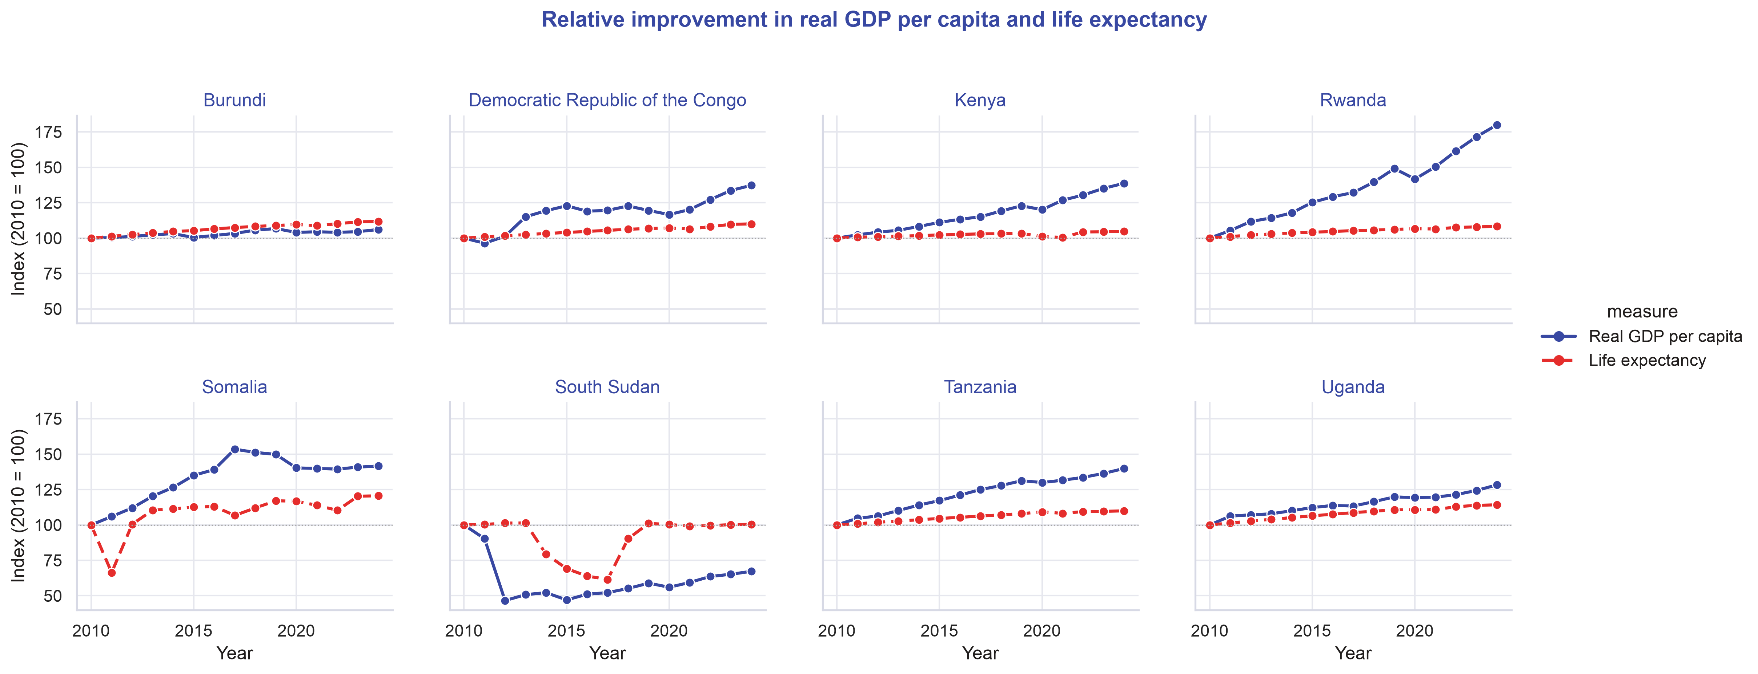
RESEARCH QUESTION 2
Relative Improvement in GDP and Life Expectancty
Answer: NO(Income grew faster than life expectancy) 0 of 8 countries improved GDP per person and life expectancy at nearly the same rate.
3.72 pp/yr
Rwanda’s gap
GDP 4.29% vs life 0.57%
How we solved it
We set both measures to 100 in the first year, calculated annual rates, and compared them.
GROUP 1 · EAST AFRICAN COMMUNITY
09

Slide 11
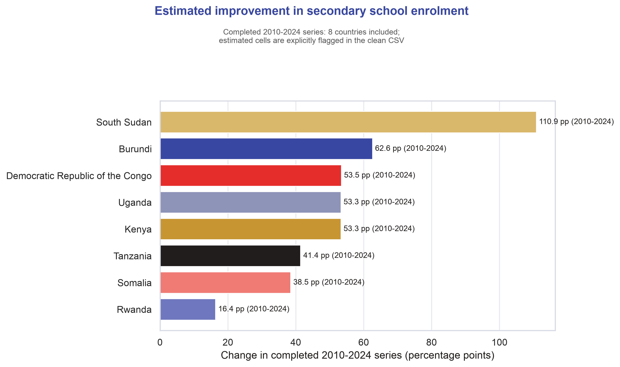
RESEARCH QUESTION 3
Secondary School Enrolment Rate
Provisional answer: (South Sudan leads estimated enrolment gains—with caution) +110.9 percentage points from 2010 to 2024; only 3 of 15 years were reported.
3 reported
South Sudan years
12 years were imputed
How we solved it
We completed a 2010–2024 yearly panel, compared each country’s endpoints, and ranked the change. Then we checked how much of each result was reported versus estimated.
GROUP 1 · EAST AFRICAN COMMUNITY
10

Slide 12
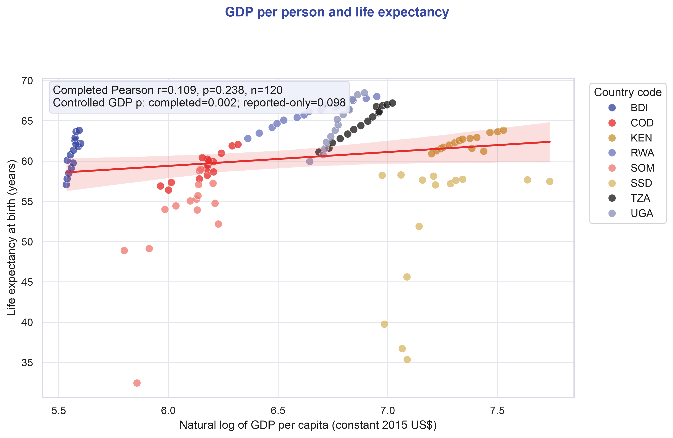
RESEARCH QUESTION 4
GDP per Capita and Life expectancy
Answer : (The GDP–life expectancy answer is model-sensitive)the conclusion changes after imputation and controls, so the relationship is not robust.
0.109
0.098
completed r
reported-only p
p = 0.238; not significant
controlled GDP effect
Explanation:
We found no reliable evidence that GDP growth alone explains life expectancy. Some models showed a relationship, while others did not, so we treat the result cautiously and do not claim that higher GDP automatically causes people to live longer.
GROUP 1 · EAST AFRICAN COMMUNITY
11

Slide 13
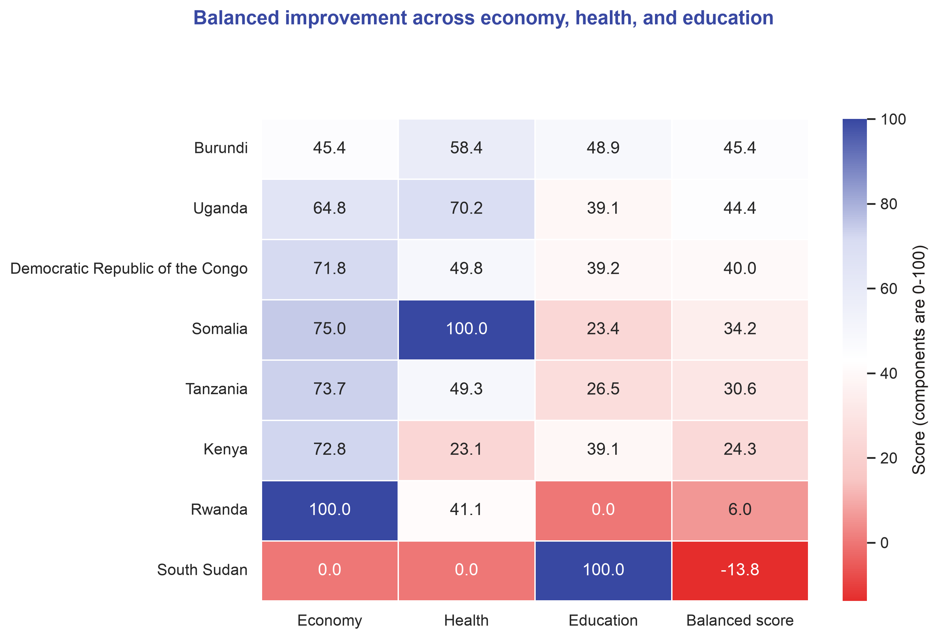
RESEARCH QUESTION 5
Balance improvement – economy, health & Education
Answer: (Burundi leads on balanced improvement)Burundi ranks first on our three-part balance score with 45.4 points.
45.4
balanced score
higher means more even progress
Burundi’s components
Economy 45.4
Health 58.4
Education 48.9
GROUP 1 · EAST AFRICAN COMMUNITY
12

Slide 14
EXPECTATION 7 · POLICY RECOMMENDATIONS
Five evidence-based actions for the EAC
Evidence
Recommended EAC action
01
0 of 8 countries matched GDP and life-expectancy rates.
Attach clear health targets and budgets to regional growth programmes.
02
Secondary enrolment was only 43.3% complete before cleaning.
Adopt one annual EAC education reporting standard with public completeness checks.
03
South Sudan’s +110.9 pp result has 3 reported and 12 imputed years.
Validate the series before copying any apparent education success.
04
Burundi leads balance at 45.4; economy is its weakest component.
Use a three-pillar scorecard so one strong area cannot hide another weak area.
05
GDP–life conclusions change across complete and reported-only models.
Evaluate health and education policies directly instead of assuming GDP will improve them.
GROUP 1 · EAST AFRICAN COMMUNITY
14

Slide 15
CLOSING REMARKS
The region’s progress is real but uneven
Fastest income growth
Most balanced progress
Most important warning
Rwanda
Burundi
Result depends on model
+80.0% real GDP/person
45.4 on our three-part score
imputation and controls matter
Client message
Track economic growth, health and education together and fix the education data gap first.
GROUP 1 · EAST AFRICAN COMMUNITY
16

Slide 16
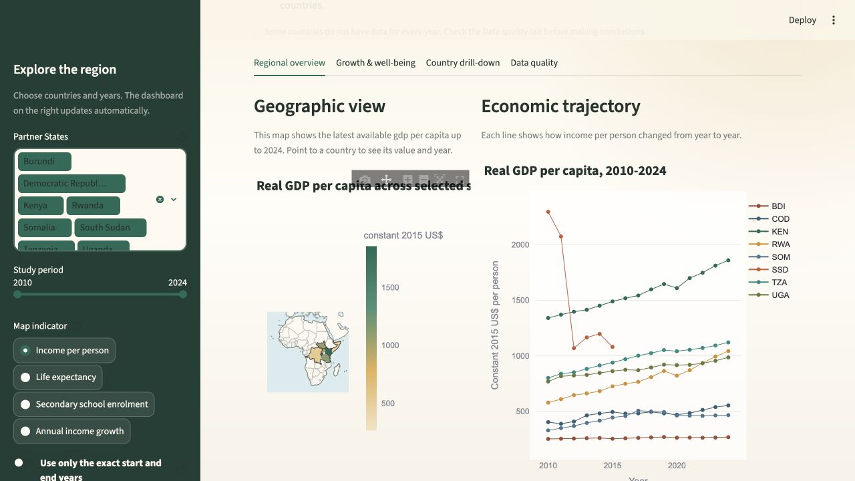
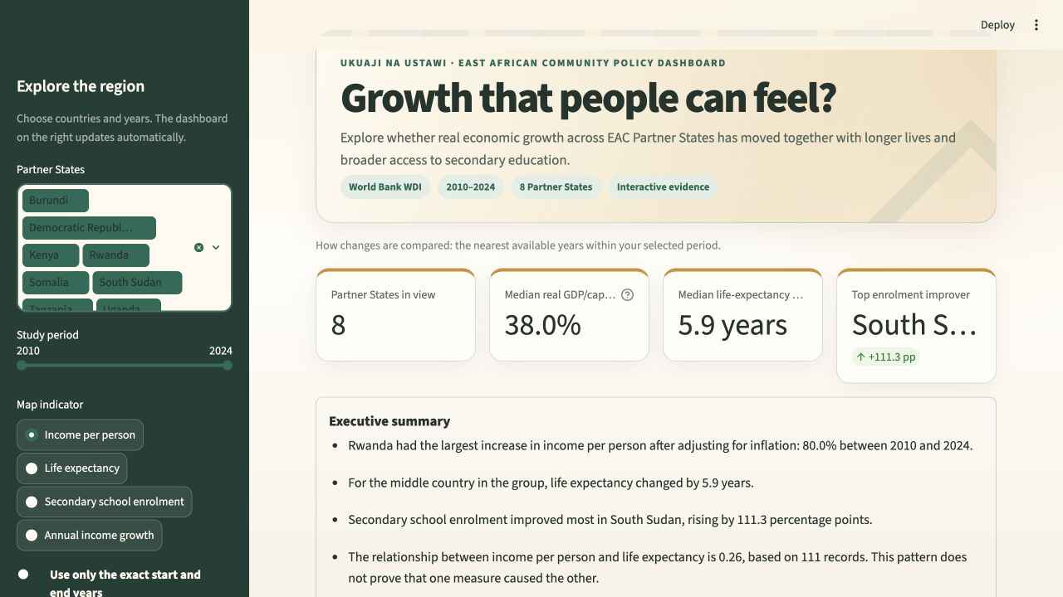
EXPECTATION 6 · INTERACTIVE DASHBOARD
Streamlit Dashboard Review
Dashboard link: https://eac-quality-of-life-dashboard.streamlit.app
What we built
4 KPI cards and a live summary
Filters kept visible at the top of the sidebar
6 interactive charts, including a map
Country drill-down and CSV download
Data-quality tab and exact-year toggle
GROUP 1 · EAST AFRICAN COMMUNITY
13

Slide 17
FINAL DELIVERABLES
Submission package & GitHub
Included
GitHub repository
Google Colab notebook (.ipynb)
https://github.com/Mutevu-Joel/eac-quality-of-life-dashboard
Raw World Bank responses (.json)
Cleaned analysis dataset (.csv)
Streamlit dashboard project
Thank you
Presentation slides (.pptx)
GROUP 1 · EAST AFRICAN COMMUNITY
17

